Slide 1

INFINITY | TRACK: AI
Threat Intelligence
Fusion & Prioritisation
Platform
AI-powered SOC solution for multi-source threat fusion & prioritisation
TEAM INFINITY
TEAM Mansi Kadia, Ashka Patel, Panha Patel, Khushi Palande
SEPTEMBER 15, 2026
INFINITY / AI-POWERED SOC
01

Slide 2
THE PROBLEM
Alert volume is rising.
Analyst capacity isn’t.
HUNDREDS
raw alerts every hour
30–90
minutes of manual D2 correlation
per incident
False positives create debilitating fatigue. Genuine threats are delayed—or missed—while organizational risk compounds.
INFINITY / AI-POWERED SOC
02

Slide 3
CORE SOLUTION
From noisy feeds to
explainable decisions
MULTI-SOURCE
INGEST
NORMALISE +
SHA-256 DEDUPE
CORRELATE
RULES C0–C5
WEIGHTED
RISK SCORE
MITRE ATT&CK
CONTEXT
BOB AI
INDEPENDENT REVIEW
Deterministic correlation and transparent component scores remain auditable—while Bob adds an independent reasoning layer via MCP.
INFINITY / AI-POWERED SOC
03

Slide 4
PLATFORM CAPABILITIES
Five capabilities. One prioritisation loop.
01
MULTI-SOURCE INGESTION
02
DETERMINISTIC CORRELATION
03
EXPLAINABLE RISK
SIEM, sensors, satellite and intelligence reports enter one normalised pipeline.
Rules group related alerts into incidents and auto-classify them.
Five component scores are surfaced individually—not hidden in a black box.
04
BOB AI REVIEW
05
DUAL-LAYER DASHBOARD
Independent classification, rationale, BLUF summaries and agreement tracking.
Pipeline and AI assessments sit side-by-side with MITRE ATT&CK context.
INFINITY / AI-POWERED SOC
04

Slide 5
IBM BOB AI INTEGRATION
Independent reasoning.
Shared evidence.
DETERMINISTIC PIPELINE
Rules · components · decision
IBM BOB AI
Classify · explain · BLUF
MCP SERVER
agreement_status
Combined deterministic + AI decisions preserve explainability and auditability.
INFINITY / AI-POWERED SOC
05

Slide 6
TECHNOLOGY STACK
Built for speed, clarity
and zero-config deployment
EXPERIENCE
React 18 · Vite · TailwindCSS · shadcn/ui · TanStack Query
SERVICES
FastAPI · SQLAlchemy · Pydantic v2
ZERO
CONFIG
INTELLIGENCE
IBM Bob · Model Context Protocol
FOUNDATION
Python 3.11 · TypeScript · SQLite
File-based SQLite and containerized delivery keep local setup friction low.
DELIVERY
Docker · Compose · GitHub Actions · Pytest · Vitest
INFINITY / AI-POWERED SOC
06

Slide 7
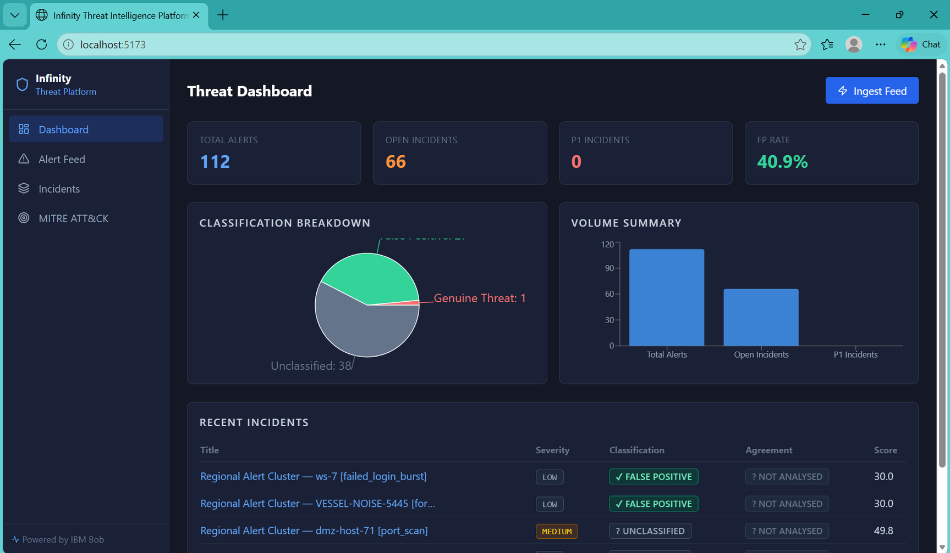
PRODUCT / ANALYST DASHBOARD
The SOC command centre
01
TOTAL ALERTS
OPEN INCIDENTS
FP RATE
Dual-layer view aligns deterministic classification with Bob AI assessment.
INFINITY / AI-POWERED SOC
07

Slide 8
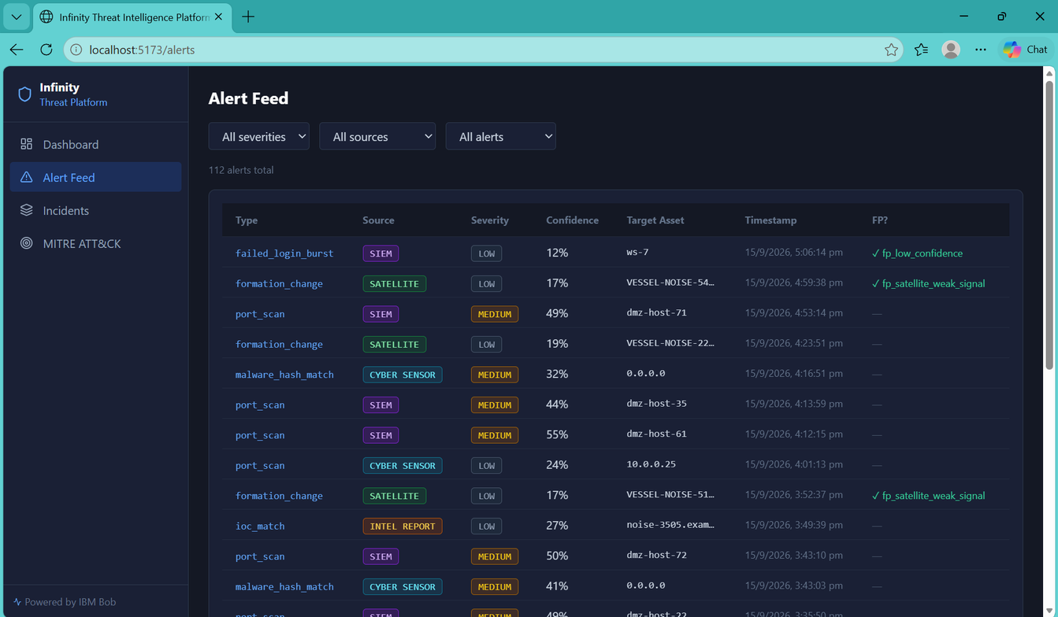
PRODUCT / ALERT FEED
Noise in. Signal out.
failed_login_burst
port_scan
malware_hash_match
ioc_match
Filter by severity, source and state. SHA-256 deduplication keeps multi-source evidence clear.
INFINITY / AI-POWERED SOC
08

Slide 9
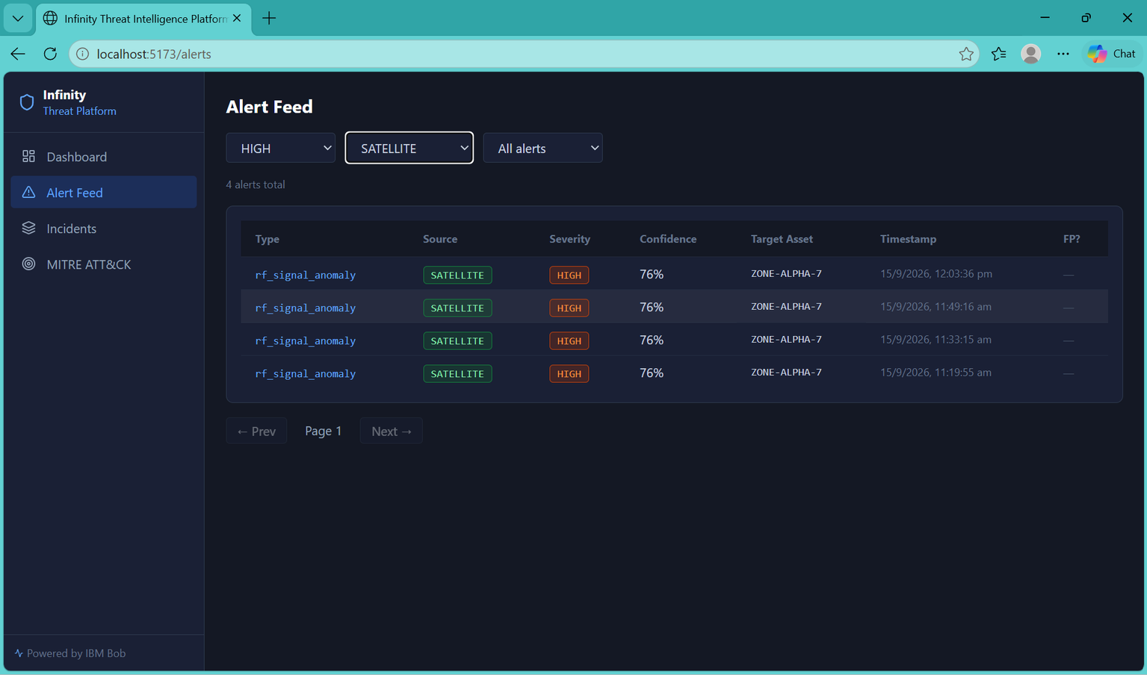
SPECIALISED SOURCE / SATELLITE
High severity.
Granular confidence.
76%
CONFIDENCE
rf_signal_anomaly
ZONE-ALPHA-7
INFINITY / AI-POWERED SOC
09

Slide 10
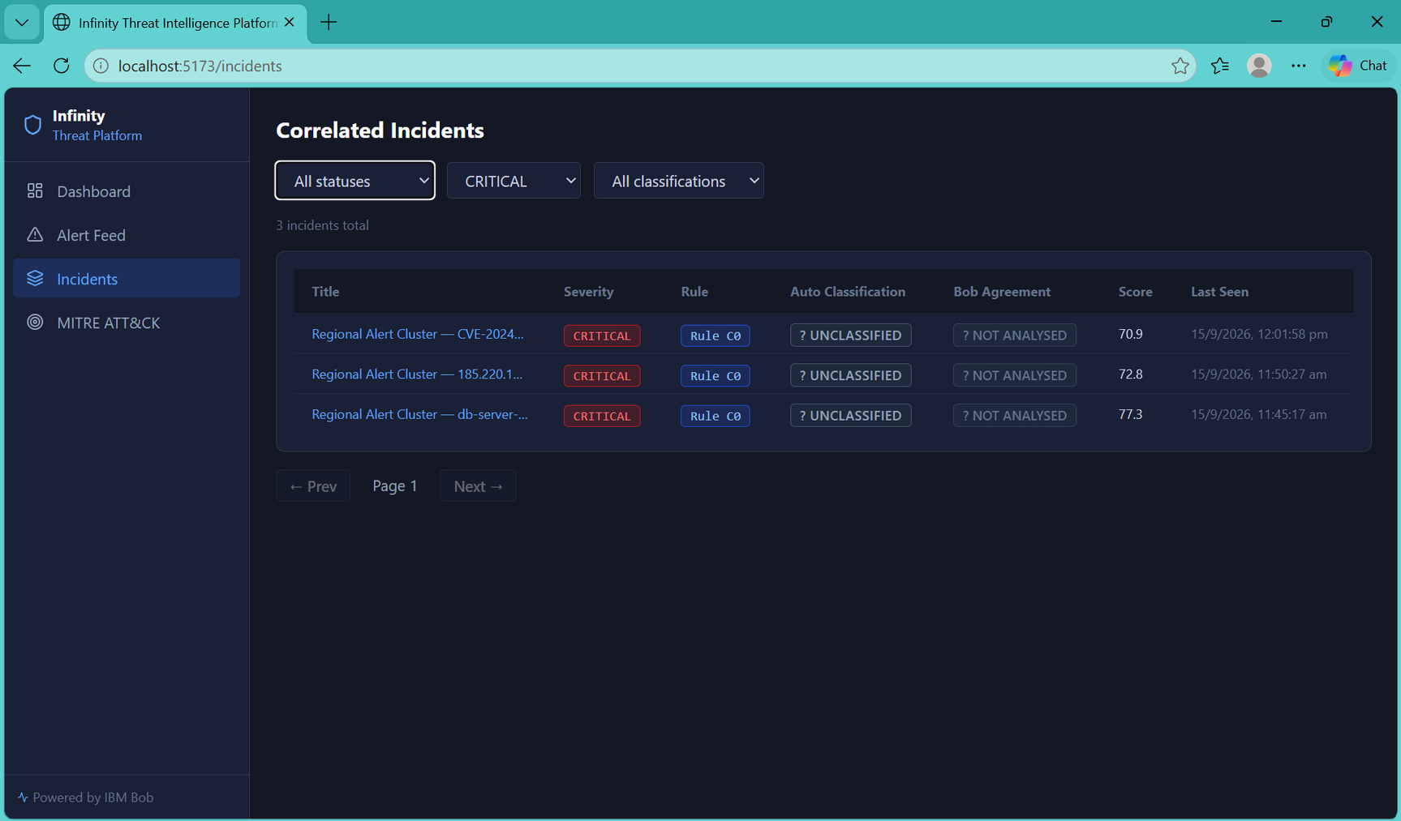
PRODUCT / CORRELATED INCIDENTS
One incident. Two assessments.
PIPELINE
DECISION
BOB AI
REVIEW
Status, severity, correlation rule, score and last seen—plus Bob agreement at the point of decision.
INFINITY / AI-POWERED SOC
10

Slide 11
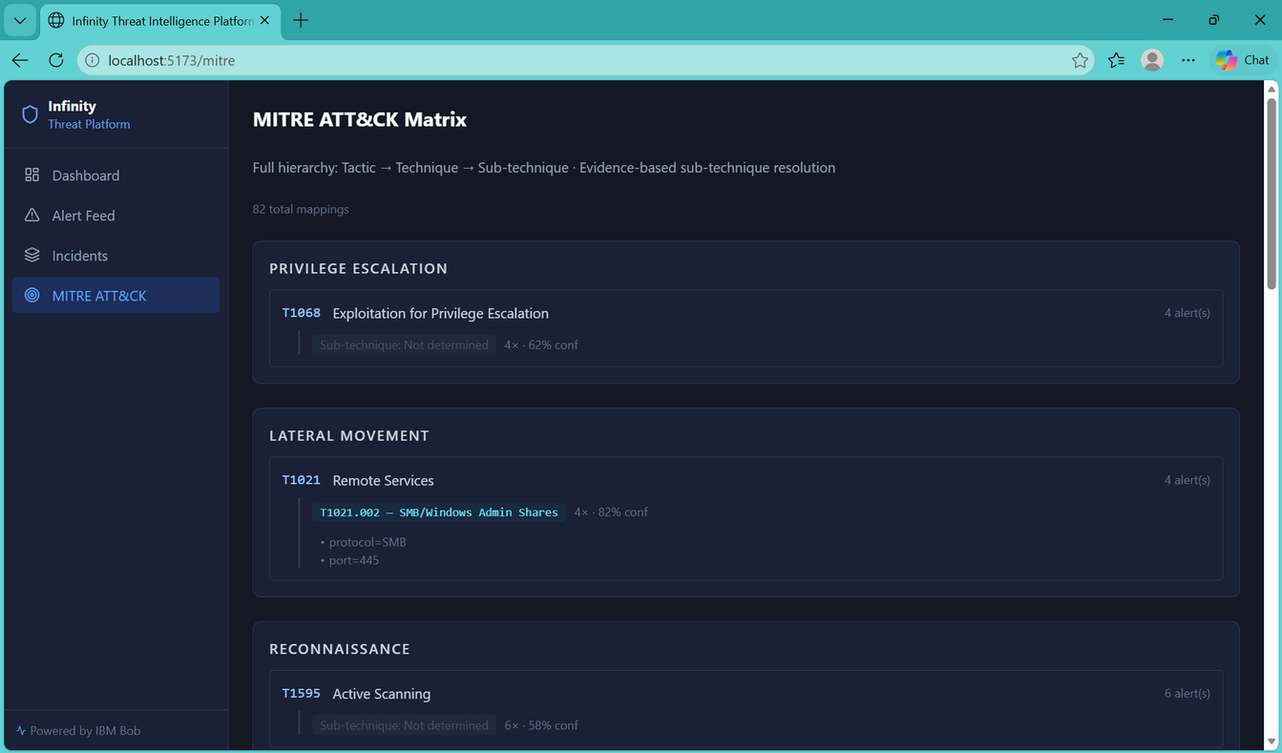
CONTEXT / MITRE ATT&CK
Translate incidents into
adversary behaviour
T1068 Privilege Escalation
T1021 Lateral Movement
T1595 Reconnaissance
T1110 Credential Access
T1071 Command & Control
T1190 Initial Access
T1642 Collection
T1041 Exfiltration
T1046 Discovery
Mapped tactics and techniques give analysts faster context for investigation and response.
INFINITY / AI-POWERED SOC
11

Slide 12
VALUE / NEXT STEPS
Minutes, not 90.
Prioritise genuine threats. Reduce false-positive noise. Keep every decision explainable and auditable.
FASTER TRIAGE
CLEARER DECISIONS
TRUST BY DESIGN
From manual correlation to actionable incidents in minutes.
Component scores, MITRE context and automated BLUF summaries.
Deterministic rules and independent AI reasoning stay visible.
Thank you — let’s build the future of SOC intelligence together.
Solution walkthrough github.com/KadiaMansi007/bob-ai-hackathon-Infinity · team.infinity@ibm.com
INFINITY / AI-POWERED SOC
12

